Slide 1
Requirement review/analysis in practice
Kornel Filep 2023.10.03.
kornel_filep@epam.com
CONFIDENTIAL | © 2021 EPAM Systems, Inc.

Slide 2

Kornel Filep
Senior Software Engineer in Test
Working for EPAM since June 2019
Java, JavaScript, TypeScript, Swift
Cloud computing using AWS
2

Slide 3
Why review/analysis is neccesary/benefical?
Early issue finding/detection
Decrease cost
Identify dependencies early
Early involvement

Slide 4
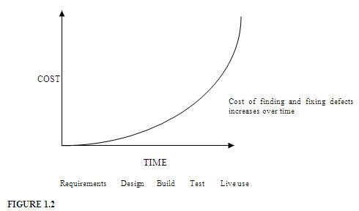
Cost of finding&fixing Defects

Slide 5

Who participates in the review?
The whole team:
PO, BA (client) - the authors
Solution Architect (solution design)
UX designer
Dev, QA team
Domain experts
External helpers
Notes:
Sok ember fel van sorolva, ha scrum csapat lehet 12-13 ember is
Hogy elkerüljük ezt a kiesést a teljes csapat analysis előtt szoktak úgynevezett 3 amigos vagy 4 amigos elemzéseket is tartani.
3 amigos esetén PO, Dev lead, QA lead
4 amigos esetén PO, SA, Dev lead, QA lead

Slide 6
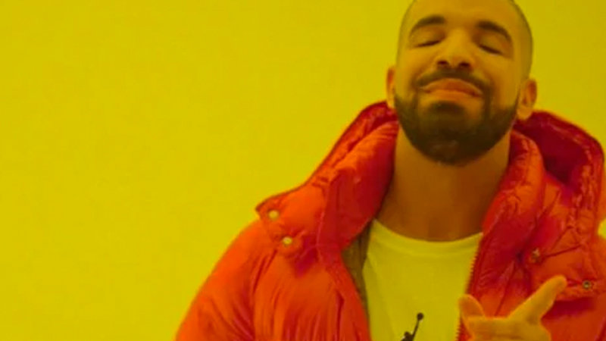
Requirements, Why do we care about it?
Should be complete and understandable.
The application should be intuitive and follow the functional requirements.
The main user scenarios should be executable without issues.
The non-functional requirements (performance, security, etc…) should be met.
The requirements should add value to the application.
Notes:
The requirements are important for testing because we compare the actual behavior with the expected one described in the User Stories.
We create the bugs and defects based on the requirements.
We have to find the Stories which are inconsistent.

Slide 7
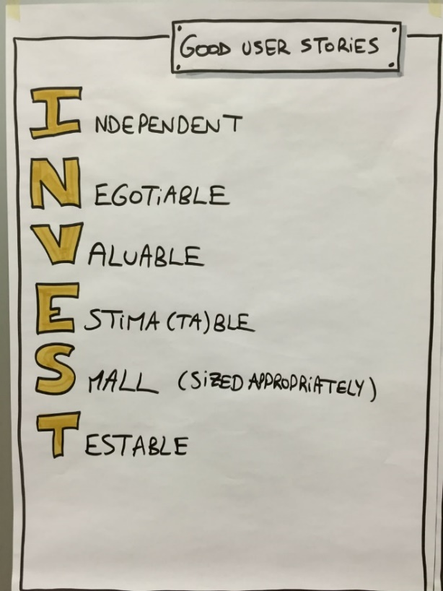
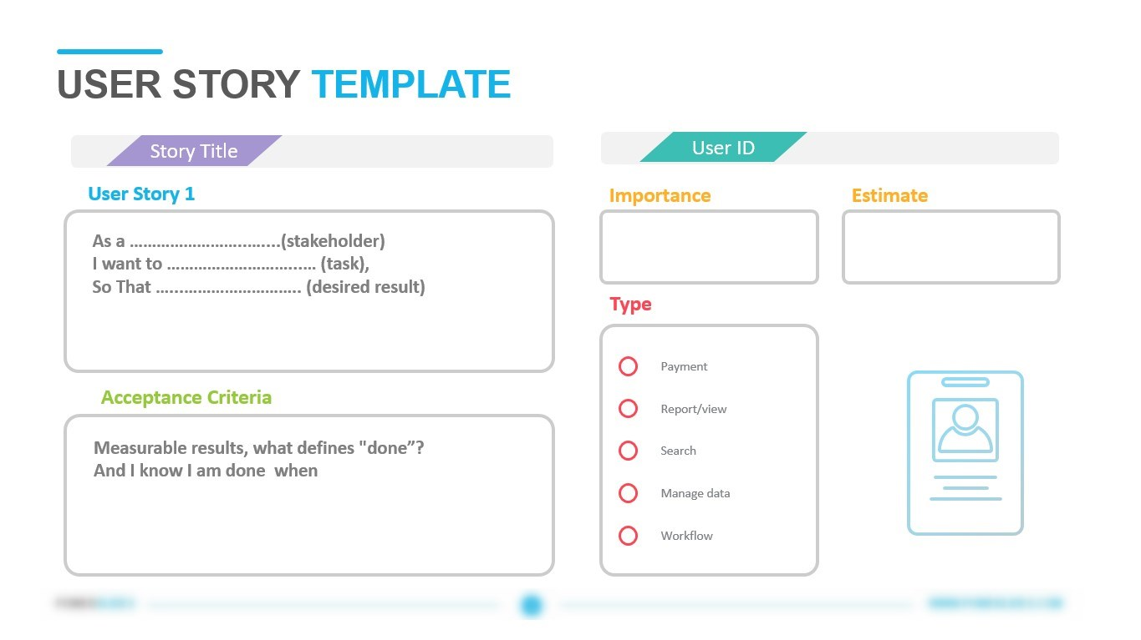
Criteria of a good requirement
INVEST method
User story template
Checklist
Notes:
Independent One user story should be independent of another (as much as possible). Dependencies between stories make planning, prioritization, and estimation much more difficult. Often enough, dependencies can be reduced by either combining stories into one or by splitting the stories differently. Negotiable A user story is negotiable. The "Card" of the story is just a short description of the story which do not include details. The details are worked out during the "Conversation" phase. A "Card" with too much detail on it actually limits conversation with the customer. Valuable Each story has to be of value to the customer (either the user or the purchaser). One very good way of making stories valuable is to get the customer to write them. Once a customer realizes that a user story is not a contract and is negotiable, they will be much more comfortable writing stories. Estimable The developers need to be able to estimate (at a ballpark even) a user story to allow prioritization and planning of the story. Problems that can keep developers from estimating a story are: lack of domain knowledge (in which case there is a need for more Negotiation/Conversation); or if the story is too big (in which case the story needs to be broken down into smaller stories). Small A good story should be small in effort, typically representing no more, than 2-3 person weeks of effort. A story which is more than that in effort can have more errors associated with scoping and estimation. Testable A story needs to be testable for the "Confirmation" to take place. Remember, we do not develop what we cannot test. If you can't test it then you will never know when you are done. An example of non-testable story: "software should be easy to use".
What parts the requirements should have?
As far as I know you already familiar with the Jira.
Then of course important information:
Reporter, Assignee, Status, Priority, Tracebility matrix, AC, Design,

Slide 8
Examples of INVEST method violations
Independent: Login UI part without backend, inexistent DB, no chosen technology, no UI skeleton
Negotiable: Login US with well-defined UI, backend, service layer requirements, design, user scenarios, implementation strategy, without the possibility of any modification
Valuable: Separate US for Username and Password field in case of login
Estima(ta)ble: Login US, DB included, but the implementation strategy, usable technology is not yet known (part of the requirements are not clear/ambigous)
Small (sized appropriately): Login feature with header, footer and advertisements on the login page (the user story is in fact an epic)
Testable: Login US to be implemented completely, but it is not possible to create test users (lack of test DB, lack of environment config)
Notes:
Példák invest technika bukásaira, címekkel

Slide 9
Exercise 1 – Review and analyse a User story
Review the given User story and try to find:
What is missing?
What could be improved?
What criteria are violated?
Notes:
Registration and login form >> should be devided into 2 stories
Full name >> should be devided into First name and Last name fields Missing: input field for email, password
Minimum 3 character >>Ba U (burmai politikus) neve?
Létrehozni a jirában >> attachment csak loginról
Registration button should be a big green button >> képen nem zöld
DB as the dev team wants>> DB lehet külön ticket / technical task ezen belül
Supported browsers: Chrome, Safari, Unsupported: IE11 >> mi a helyzet a többivel, melyik layout supportált?
Writing automated tests is optional >> opcionalitás miatt nem esztimálható
Important input fields should be mandatory >> what fields are the „important” ones?
Input field validation >> melyik fieldekre, mit fogadjunk el?
Email after registration should contain company logo, signature, link to confirm registration >> megszólítás, kinek küldi, mi célt szolgál a link, ha nem ő regisztrált mi a teendő
Registration with the same name should not be allowed >> inkább email cím
>> Userflow not included
As a user, I want to have a registration and login form >> (without reasoning)

Slide 10
Exercise 2 – Review a known User story in Jira
Review the User story from the last lesson and try to find:
What is missing?
What could be improved?
What criteria are violated?

Slide 11
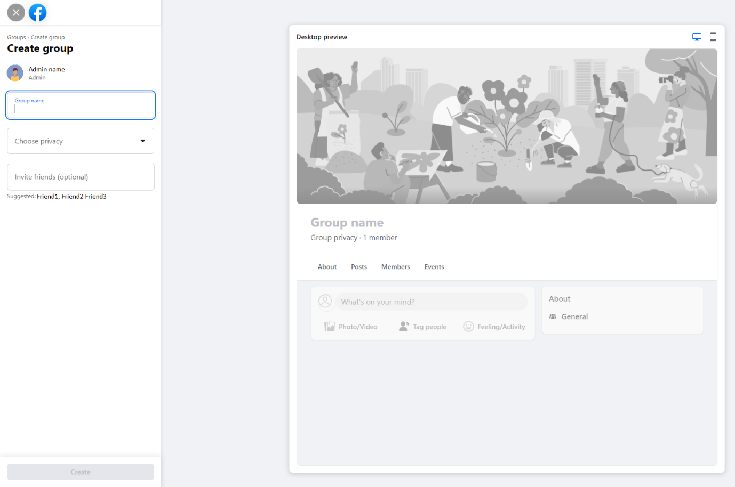
Exercise 3 – Create a new User story
Create a User story for the Groups functionality

Slide 12
Thank You for your attention
kornel_filep@epam.com

